Slide 1
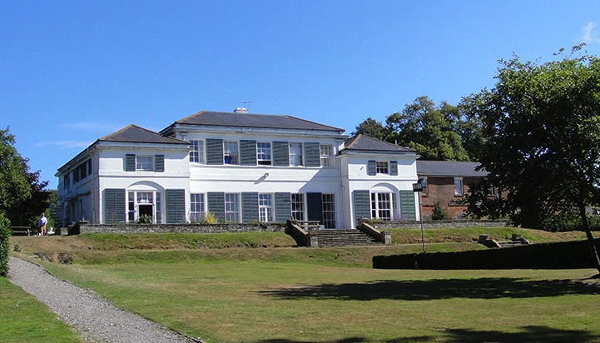
Windmill Hill East Sussex

Slide 2
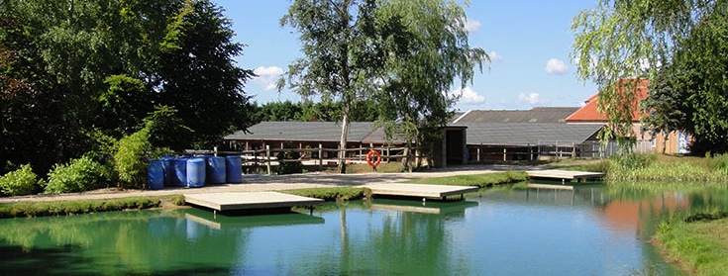
LEARNING OUTSIDE
Windmill Hill – East Sussex
23 fantastic adventure activities to choose from
Large indoor sports hall
Lakes for watersports and outdoor heated pool
Explore the 360 Virtual Tour www.pgl.co.uk/windmill360 to see inside the centre and view activity information and videos

Slide 3
Multi-Activity
4 action-packed adventure activity sessions per day
Evening entertainment
Great for personal development & confidence building
Increases motivation & appetite for learning
Notes:
Benefits of a multi-activity course include:
- improved self confidence
- improved team-building skills
- better peer group relationships
- raised self esteem
- increased motivation

Slide 4
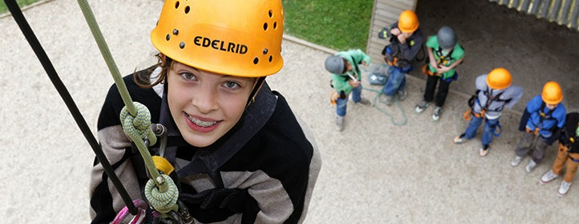
Adventure activities
Abseiling
Aeroball
All Aboard
Aquafun
Archery
BMX
Canoeing
Challenge Course
Climbing
Eco Trail
Fencing
Giant Swing
Hiking
Jacob’s Ladder
Orienteering
Problem Solving
Raft Building
Rifle Shooting
Sensory Trail
Sports and Team Games
Trapeze
Tunnel Trail
Zip Wire
Notes:
The activities shown offer individual as well as team challenges
Activities are designed to encourage new skills and develop existing ones
Specific activities can be requested (though not guaranteed) and the programme is discussed on arrival at the centre

Slide 5
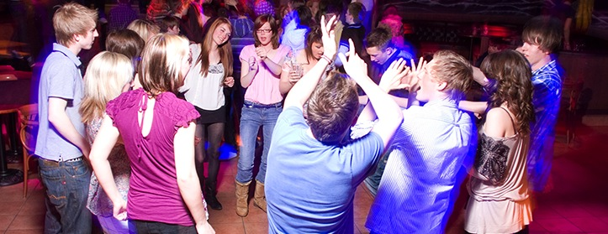
Evening entertainment
50/50
Ambush
Battle of Windmill Hill
Campfire
Capture the Flag
Casino Night
Disco
Karaoke
Passport to the World
Quiz
Robot Wars
Scrapheap Challenge
Shoe Golf
Snapchat Challenge
Space Hopper Football
Top Gear
Ultimate Frisbee
Wacky Races

Slide 6
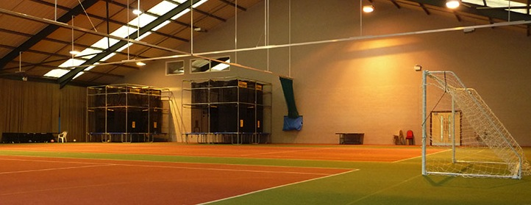
Facilities
Heated outdoor swimming pool
2000m² sports hall
Indoor games / recreation area
Sports pitches
Purpose-built BMX track
On-site adventure activities
Disco
Shop
Classrooms / meeting rooms

Slide 7
Leaving and Returning
Wednesday 25th March to Friday 27th March 2020
Just over an hour to reach Windmill Hill which is in East Sussex.
Usually set off around 9:45am and return back by the end of the school day on the Friday. (Children need a packed lunch on this day)
Final details will be shared nearer the time.

Slide 8
Staff ATTENDING
Miss Pettman- Deputy Head Teacher
Mrs Lyon-Lee– Year 4 Class Teacher
Mrs Llinas – Year 4 Class Teacher
Mrs Hollands (First Aider) – Support Staff
Mrs Place (First Aider) – Support Staff
An additional adult depending on numbers.
All PGL staff are fully DBS checked and first aid trained.

Slide 9
WHAT DOES MY CHILD NEED TO BRING?
Clothing and shoes worn outside during activities will inevitably get dirty – so old clothes are best!
With the weather being very changeable, we would suggest a mix of t-shirts and sweatshirts as the evening will still be chilly.
Leggings/tracksuit bottoms are preferable as jeans are not suitable for the activities the children will be undertaking and when wet, take a long while to dry.
Children are encouraged to take responsibility for their belongings and we therefore strongly recommend that you name all items of clothing.

Slide 10
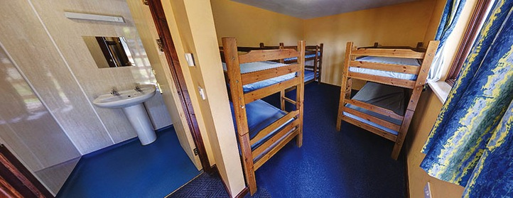
Accommodation
Lodges – en suite rooms sleep 5-6
Accommodation for Windmill Hill can be viewed in the 360 virtual tour: http://www.pgl.co.uk/windmill360
Notes:
The centre can accommodate 445 guests at a time with accommodation in the our purpose-built lodges.
Teachers are usually accommodated in twin rooms with en suite and hot drink facilities
All rooms are lockable (party leader given master key)
All exterior doors and gates are locked at night but can be opened from the inside in an emergency without the need for unlocking
A PGL staff member is available on duty throughout the night (contactable by phone)
The extensive facilities (other than activity bases) are available to your group during free time

Slide 11
Sleeping Arrangements
Children will be asked to pick two children that they would like to share with and will be guaranteed at least one of their choice.
They will be given their day groups and dormitories on arrival.
Sheets, duvets and pillows are provided for all guests and party leader rooms are at the end of each corridor.

Slide 12
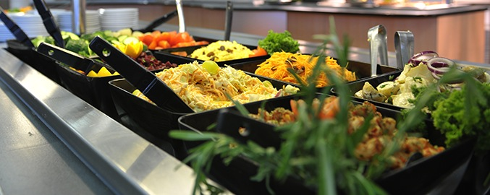
Catering and dietary needs
3 nutritious, balanced meals per day
Self-service salad bar
Vegetarian option
Special diets catered for by prior arrangement
Sample menus available online: www.pgl.co.uk
Notes:
We continually invest in healthy menus with freshly cooked ingredients obtained from fully traceable audited suppliers
Processed food is avoided and meals meet Local Authority guidelines
There will be hot and cold options available at every meal
At lunch and dinner the buffet includes a salad bar and mixed fruit basket plus hot and cold drinks
Our caterers can deal with most dietary requirements but please ensure the party leader is aware of any dietary requirements well in advance
More food is always available if required

Slide 13
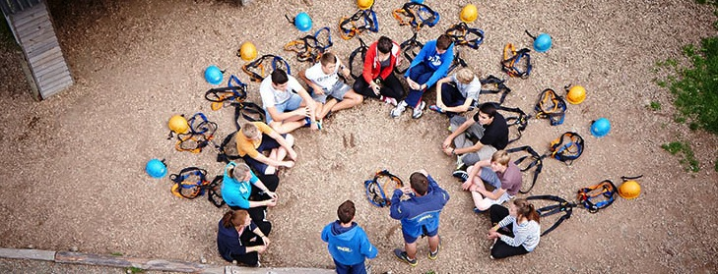
Health & safety
The PGL Code of Practice describes all safety and operational procedures both on and off-site including:
Sample risk assessments
Staff-to-pupil ratios
Operating procedures
Staff vetting & training
Site security
First Aid procedures
Emergency procedures
www.pgl.co.uk/cop
Notes:
Please see Code of Practice for further detail
All centres and activities are fully risk assessed every year
The PGL Code of Practice details all the control measures put in place to minimise risk
Sample risk assessments are available on line and specific assessments are available from PGL on request
Staff-to-pupil ratios comply with recognised industry standards
Operating procedures all comply with recognised industry standards and National Governing Body guidelines where these are relevant
PGL recruitment officers have extensive experience at a senior level on centre and make selections based on a detailed application form
Two formal written references are taken and applicants have to provide documentary evidence of all qualifications claimed
All offers of employment are subject to DBS checks, the successful completion of pre-employment training and a favourable probationary period
All our instructors are specifically trained for our programmes to ensure the delivery of safe and rewarding sessions across a wide range of activities
At every PGL centre there is an experienced and professional Centre Manager (supported by Senior Staff) who is in charge of centre operations and has overall responsibility for the success of the course and the performance of our staff
It is the policy of PGL to take all reasonable steps to ensure the safety and security of all guests and staff on our centres (details in Code of Practice)
Each centre has at least two First Aid staff who hold the “First Aid at Work” qualification and in addition all our instructors and group leaders complete an 8 hour first aid course. Party Leaders and teachers will ultimately remain responsible for the administration of first aid to their party members
There are rigorous general accident and emergency procedures in place
Through the Quality Badge Programme you can be confident that recognised providers fulfil all the necessary criteria as laid down by the DfE, thereby better enabling Party Leaders to manage visits safely, efficiently and beneficially

Slide 14
Final cost
All payments must be paid via SIMS Agora and balance must be settled prior to departure.
The cost per child is £265.00
If you have paid the £40.00 deposit
Balance is: £225.00 to be paid by the beginning of March.
They can bring £5.00 pocket money but this has to be brought and given to an adult on the day we leave.

Slide 15
Any questions?
https://www.pgl.co.uk/Files/DocumentManagerDocuments/AdventureUK/Promotional%20Videos/PGL-Promotional-Video-Primary-Schools-Parents-and-Pupils-Whats-It-All-About.mp4

