Slide 1
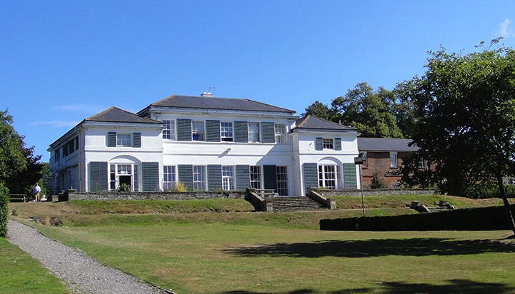
Windmill Hill East Sussex
Wednesday 25th – Friday 27th March 2020

Slide 2
FINAL Staff ATTENDING
Miss Childs – Head of School
Mrs Lyon-Lee– Year 4 Class Teacher
Mrs Llinas – Year 4 Class Teacher
Mrs Hollands (First Aider) – Support Staff
Mrs Place (First Aider) – Support Staff
Mrs Bailey (First Aider) – Support Staff
All PGL staff are fully DBS checked and first aid trained.
All activities are fully risk assessed and equipped.

Slide 3
ROOM ALLOCATION
Children will sleep in rooms of 6 (no mixed gender).
Children have chosen 2 children they would like to share with and will be with 1 of these – children told on arrival.
All rooms have en-suite shower and toilet facility.
All rooms are together.
4 staff bedrooms at the end of each block of rooms.
Rooms have x3 bunk beds.
Children expected to make their own beds on arrival and keep their room tidy.

Slide 5
Activities
Children grouped into 4 groups of 12 pupils. Staff allocated to a group for the three days.
Mixed across classes but with a friend (set by teachers)
Activities include:
Abseiling
Raft building
Archery
Sensory trail
Camp fire

Slide 6
WHAT DOES MY CHILD NEED TO BRING?
Clothing and shoes worn outside during activities will inevitably get dirty – so old clothes are best (refer to kit list)
With the weather being very changeable, we would suggest a mix of t-shirts and sweatshirts as the evening will still be chilly.
Leggings/tracksuit bottoms are preferable as jeans are not suitable for the activities the children will be undertaking and when wet, take a long while to dry.
Toiletry bag containing: toothbrush/paste, shower gel/soap, shampoo and anything else used by your child.

Slide 7
DON’T FORGET…
Black sack for dirty washing
Plenty of socks
Change of jumper/zip up cardigan
Waterproof coat
Disposable camera
£5 pocket money (in a named envelope please)
Children are encouraged to take responsibility for their belongings and we therefore strongly recommend that you name all items of clothing.
No electrical items please – no mobile phones, tablets, devices or items of value.

Slide 8
DATE OF DEPARTURE – WED 25TH MARCH
Children need to arrive from 9:30am via the car park entrance.
If the weather is dry, suitcases to be left outside by the back steps
Coach is arriving at 9:45am and departure will be at 10:00am
Please sign your child in by the car park entrance
Medicines to be signed in by parent to Mrs Place/Mrs Hollands in the main hall. Calpol is not needed as the school have enough to administer if needed.
Please remember inhalers/epi-pens
£5 pocket money/letter from home to be given to Mrs Bailey in a named envelope
Children will require a packed lunch and additional drinks (no fizzy drinks) on the day of departure.

Slide 9
DATE OF RETURN– FRI 27th MARCH
Last activity finishes at midday.
Depart after lunch and expect to be back at 3:30/3:45pm
Collection will be from car park.
Parents kept informed via parent mail
Parents will be kept updated during the three days and will be informed of safe arrival and journey home.

Slide 10
FINAL REMINDERS
NO Nuts please in packed lunches or treats. Pupils with nut allergies are attending.
Children permitted to bring some treats but we ask that this is restricted to a small bag of sweets.
Children can bring activities for the coach/down time such as book, colouring, board games etc. Any electrical devices will be confiscated for safe keeping.
Remaining balance – we ask that this is settled by Monday 2nd March at the latest.
Any problems with payment please speak to Mrs Northfield in the office or Miss Childs.
Any final questions/queries please ask.

Slide 11
Any questions?

